Slide 1
Building Your Team to Last: Successful Onboarding and Mentoring Practices
Sarah E. Withee

Slide 2
Building Your Team to Last: Successful Onboarding and Mentoring Practices
Introduction
Misconceptions about junior devs
Experience vs. Ability
Effective Relationships
Benefits for junior devs/ interns
Benefits for senior devs
Ready for juniors
Where to go from Here
Notes:
Abstract
Junior developers are often billed as The Answer to the talent shortage in tech and the chronic homogeneity of the tech industry. Hiring a junior developer, however, is the start and not the end of this process.
This talk will cover onboarding and mentoring junior developers successfully. We’ll discuss the benefits of bringing junior developers onto an established team. We’ll also show how senior AND junior developers can benefit by working together during the onboarding process. Some patterns of ineffective mentoring and why they are harmful to the team will be discussed. By the end, you’ll see how your whole team will ultimately benefit from these mentoring strategies.

Slide 3
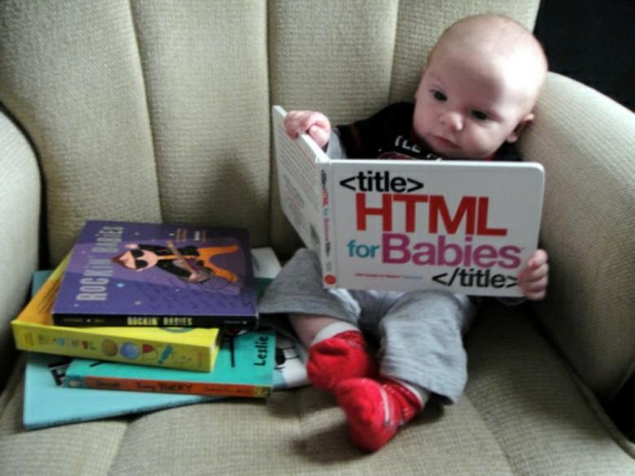
Foreword
My experiences
Juniors versus seniors
Audience aim
Notes:
Foreword
a. Experiences are my own, as well as conversations with junior and senior devs
b. Juniors are referring to fresh graduates of universities, code schools, bootcamps, or self taught devs with usually less than 2 years experience
c. Seniors are referring to people with many years of experience and usually
lead developers, architects, or other positions. For the purposes of this talk, could
include mid-level devs too
d. While written aimed at developers, it could really apply to any job group (designers, QA, tech writers, etc.)

Slide 4
Misconceptions about junior devs
Junior devs are effective mind-readers
Junior devs understand exactly what’s expected of their code as soon as they walk in the door
Juniors understand the nature of working on production code in a team
Juniors will get it right on the first try
Juniors are 20-year-olds fresh out of college/internships
Junior developers all have the same knowledge out of their education
Notes:
Misconceptions about junior devs
a. Junior devs are effective mindreaders
i. [Sarah] First task was to fix a bug on an installer I hadn’t ever seen for a product I had never heard of using Kanban (of which I hadn’t used Agile anything before)
b. Junior devs understand exactly what’s expected of their code as soon as they walk in the door
i. They aren’t taught production code in team environments in school
ii. Good practices aren’t taught often. If they are, it’s usually pretty quick
iii. [S]
c. Juniors understand the nature of working on production code in a team
i. This is often not taught in schools and is a complex part of effective engineering
ii. Often have worked with small class projects, not large ones
iii.
d. Juniors will get it right on the first try
i. They likely may not, but it’s ok, good learning practice
ii. Doesn’t development end up trying a hundred things until one thing works anyway?
e. Juniors are 20-year-olds fresh out of college/internships
i. It can be frustrating to find that companies only bring in people via internships
ii. Or that they all imagine juniors to be completely unfamiliar with working.
iii. Or that they’re all super young
iv.[Sarah] “Intern games”
f. Junior developers all have the same knowledge out of their education
i. Bootcamps, computer science degrees, IT degrees, books, workshops ...definitely not all built the same

Slide 5
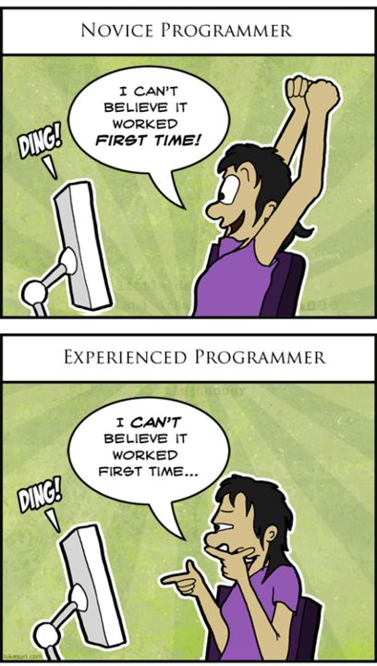
Paraphrased
Lack of experience != Lack of ability

Slide 6
What does an effective (healthy) relationship look like?
Process
Communication
Good onboarding
Consistent standards
Not relying on junior to know what they need to know all the time
Feedback, both positive and negative
Critical feedback in a positive tone
Checking in on junior regularly
Reiterating that learning the processes and procedures of the company takes time
Notes:
What does an effective (healthy) relationship look like? (positive points)
a. Process
i. Good onboarding
1. Should be planned out.
ii. Consistent standards
1. They are a part of the team and should be treated like a valued member, not just the new person or the time consuming resource
iii. Not relying on junior to know what they need to know
1. They don’t know what resources they need to succeed. YOUR job
is to show them how to.
b.Communication
i. Feedback, both positive and negative (and respectfully on negative)
1.As a junior, there’s this constant thought of am I doing this right? Is this even going to work?
ii. Critical feedback in a positive tone
iii. Checking in on junior regularly (might be shy at first)
iv. Reiterating that learning the processes and procedures of the company takes time

Slide 7
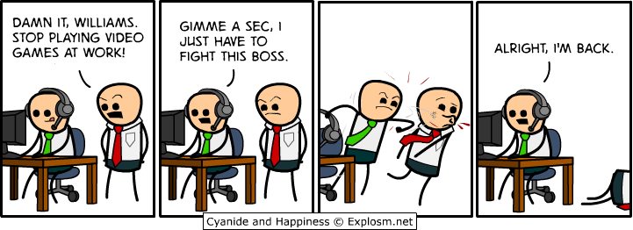
What does an effective (healthy) relationship look like?
Guidance/visioning
Pairing
Get juniors’ advice
Ensure junior understand what is going on and not just saying I understand
Notes:
Guidance/visioning
i. Pairing
1. Spend time with them WHILE coding.
2. In the beginning, help the junior out while on the keyboard.
3.Later, have the senior on the keyboard and the junior help think it through.
ii. Get juniors’advice
Ex: in a sprint planning meeting, ask them how they might break a task down
iii. Ensure junior understand what is going on and not just saying “I understand”
1. It’s easy to say I understand even when they don’t
2.

Slide 8
Benefits for junior developers/interns
Growth
Put energy to good use
Discovering interests
How does this apply to interns?
How does this apply to senior/senior dev relationships?
Cheaper/easier to hire
Notes:
Benefits for junior developers/interns
(5-7 things)
a.(Probably don’t think a lot about I have a new developer, what are they going to get out of this? How are they going to grow? )
b. Put energy to good use
i. They ’re excited to work there. Being shown the ropes and how things work will make them happier to get started and less daunted/scared
c.
d. How does this apply to interns?
e. How does this apply to senior/senior dev relationships? (Senior may be exposed to new/better technologies or a new approach to a solution
f. Cheaper/easier to hire

Slide 9
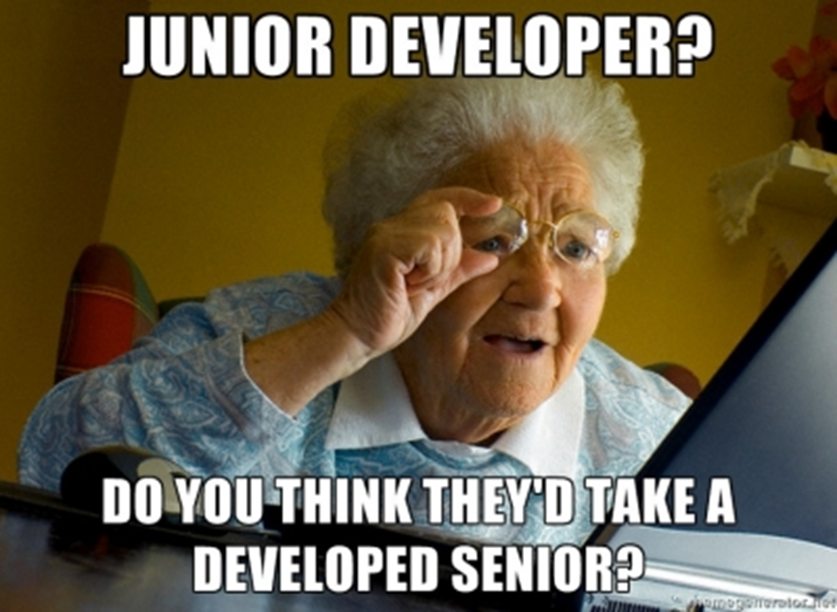

Slide 10
Benefits for senior developers
Time away from regular work
Reevaluating how you do things
More time spent in the beginning saves you MORE time down the road
See new ideas
Investing in the future of your team
Get more side work done
Notes:
a. Time away from regular work
i. Admit it: you don’t always want to be stuck fighting fires all the time
b. Reevaluating how you do things
i. Getting asked questions about your work means you have to explain it. If you have good explanations, you’re probably doing fine. If you don’t...maybe time to look at how you do things
ii. Helps eliminate invisible expectations that are in the system
iii.
c. More time spent in the beginning saves you MORE time down the road
i. If they know what they’re doing and how the process works, then there are fewer questions, and questions are more specific and less complex
d. See new ideas
i.Technology changes fast. Company’s technology doesn’t change fast.
ii. Homogenity is bad for teams. Diversity spawns innovation.
1. [Sarah] Windows service example
e. Investing in the future of your team
i. If your new engineer can learn to be self-sufficient, then your team is better off because of it
f. Get more side work done
i. Give your junior dev a project that’s on the backlog. It doesn’t have to be exciting (as they’ll find getting a p

Slide 11
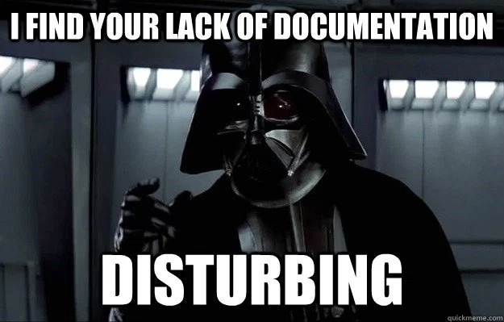
Ensuring You’re Ready for New Juniors
Do you have a senior dev that can spend time answering questions, and at least some time once a week to chat about how they’re doing?
Do you have adequate training resources? Will they be given time to learn from these?
Notes:
a. Do you have a senior dev that can spend time answering questions, and at least some time once a week to chat about how they’re doing?
b. Do you have adequate training resources? Will they be given time to learn from these?
i. Books, tutorials, documentation,
c. Will our new developer be able to grow from these experiences, even if they don’t stay at our company long? (How can they help us help them?)

Slide 12

Where do we go from Here?
Planning
Projects
Pairing
???

